Slide 1
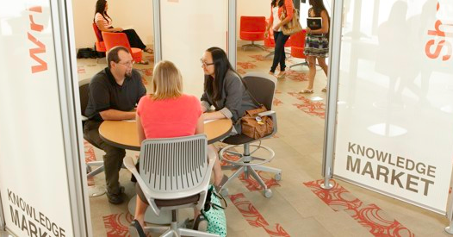
Welcome to the Michigan Library Association
Steven Bowers, MLIS
DALNET
MLA President
Gail Madziar
Executive Director
Michigan Library Association
Notes:
Photo of Mary Idema Pew Library GVSU

Slide 2
MLA Mission
Helping Libraries
and
Library Professionals
Succeed
www.milibraries.org

Slide 3
What is an association?
Who belongs?
Why belong?

Slide 4
Michigan’s Professional Library Association
Founded in 1890 and guided by the belief that free access to information is the cornerstone to a free society.
Notes:
Photo: Smithsonian libraries circa 1890

Slide 5
Membership
350+ Academic, Public, Specialty Libraries
900 Library Professionals
Student Memberships

Slide 6
Lt. Governor Brian Calley and Lance Werner MLA Past President and WSU 2017 Alumni of the Year

Slide 7
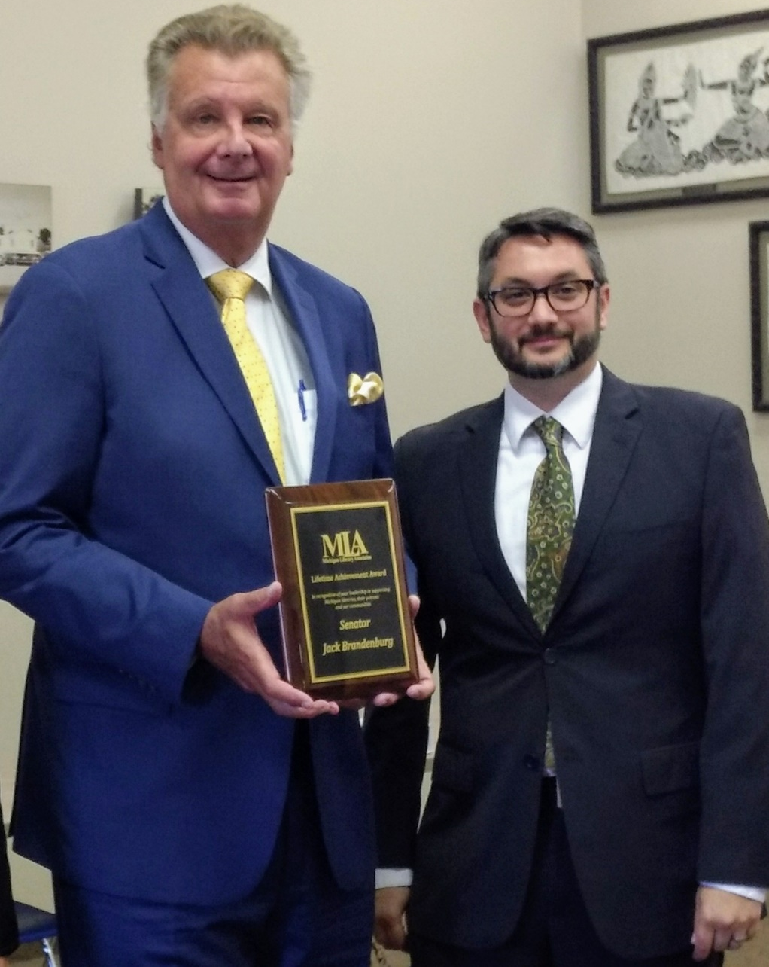
Steve Bowers and MLA Legislator of the Year Senator Jack Brandenburg at MLA board of directors meeting
Meet Your Elected Officials

Slide 8
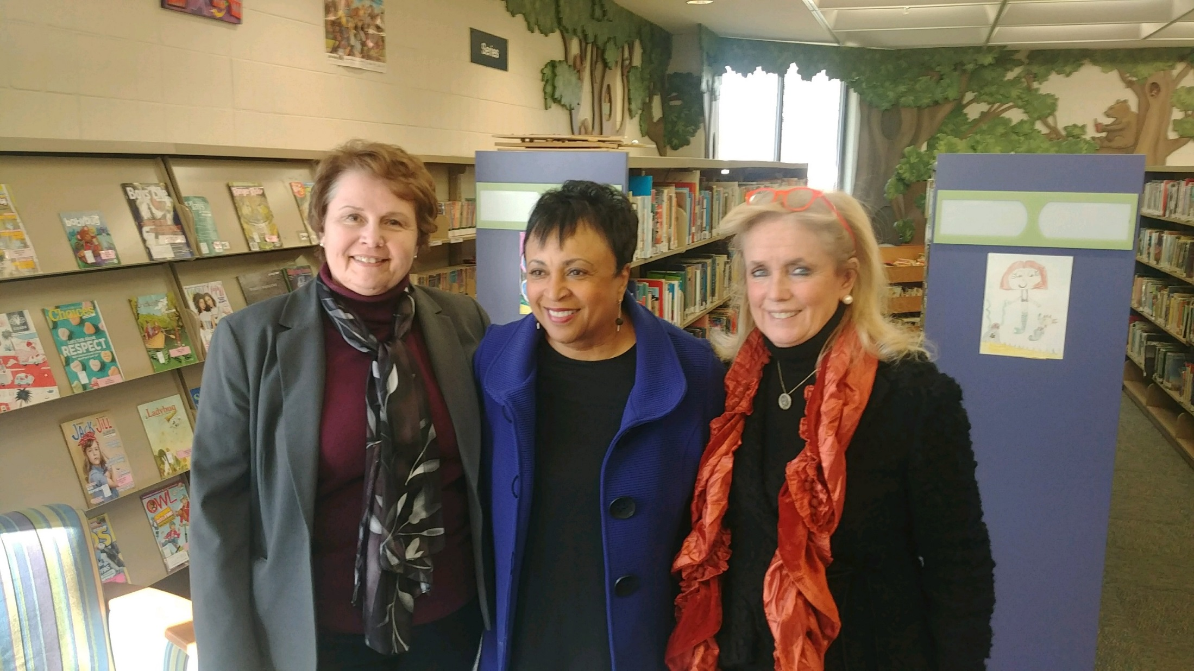

Slide 9
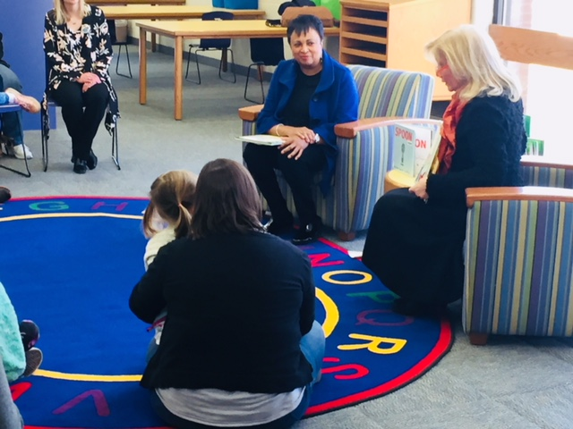

Slide 10
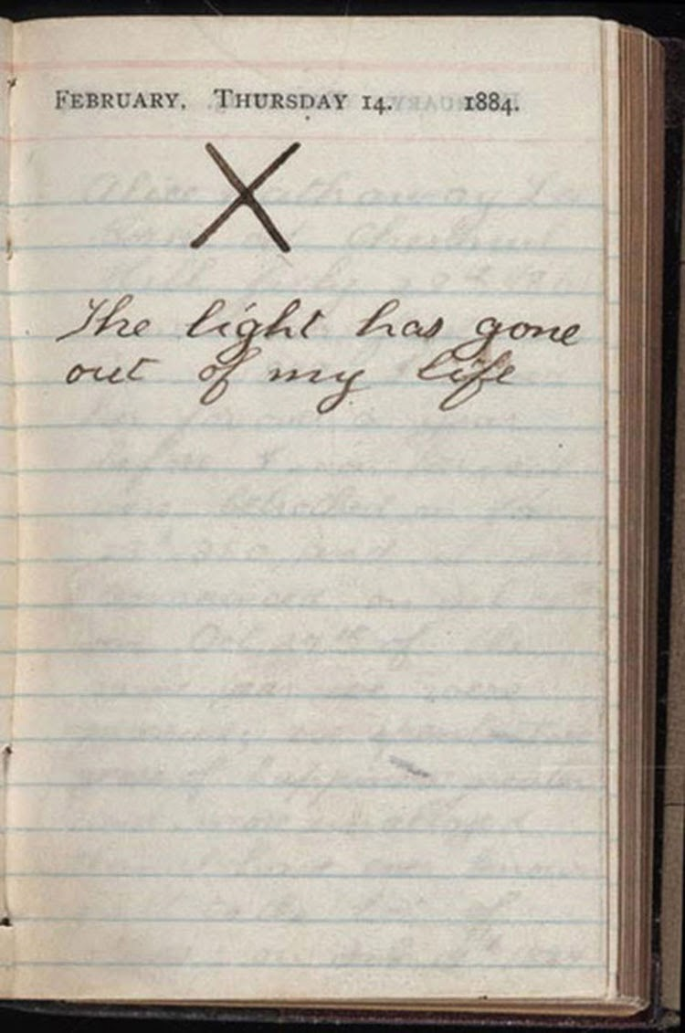
Theodore Roosevelt’s personal journal on the day both his wife and mother passed away.

Slide 11
Stay on trend
Advance your career.
Be more competitive in the job market.
Presentation and Leadership Opportunities
What you didn’t learn in library school.
Professional Development

Slide 12
Student Benefits
Joint ALA/MLA Student Membership $40 per year
Job board and resume posting
MLA Event Scholarships

Slide 13
MLA Mentor Program
Career
Confidence
Leadership
Networking

Slide 14
You Can Connect
Interest Groups
http://www.milibraries.org/membership/interest-groups/
Social Networking Sites.
Facebook @Michigan Library Association
Tweet @MLAoffice
Expand Your List of Professional Contacts
In person and virtual events and workgroups

Slide 15
Get Involved
Leadership opportunities
Serve and lead workgroups, committees and boards.
Networking
Connect with your peers from across the state.
Talk with seasoned professionals and those in their first jobs.
Career Development
MLA can assist with your job search via our Website portal
Get connected with library directors and others looking to expand their staff.
Presentation Opportunities
Statewide Conferences and workshops

Slide 16
Leadership

Slide 17
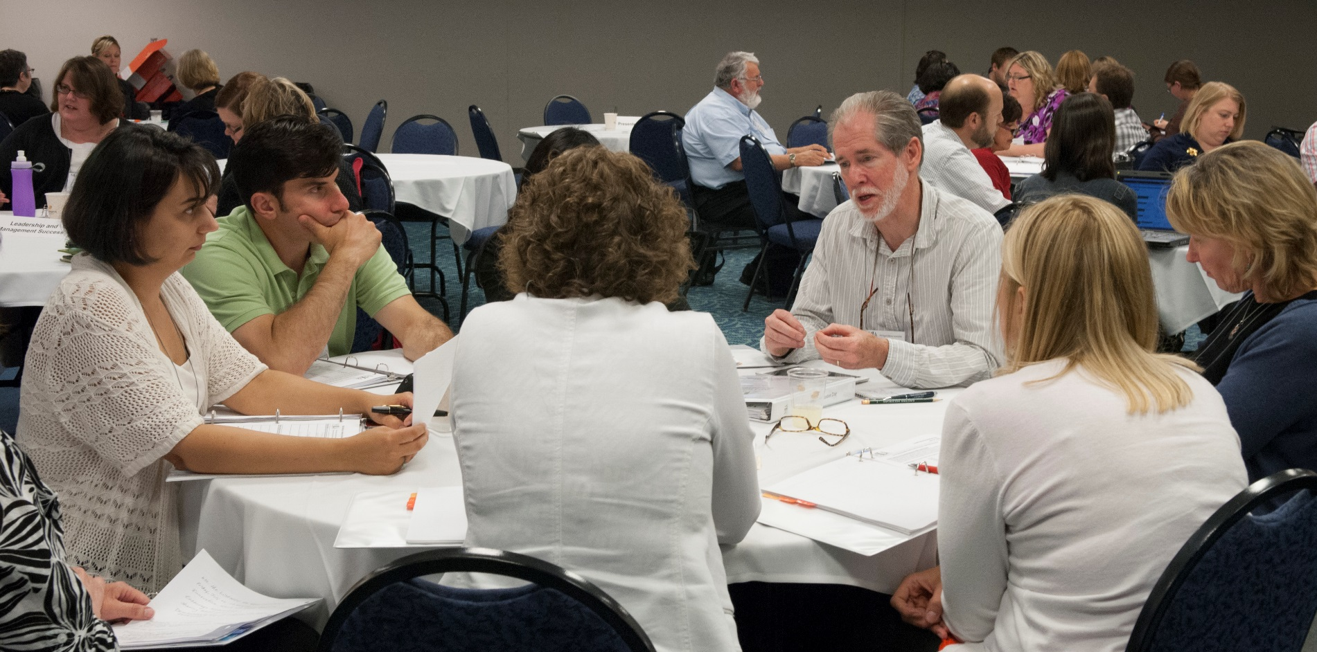
Networking

Slide 18
Career Development
The MLA Career Center
Extensive database of job postings
Résumé examples
Interviewing tips
Career articles
Helpful resources for career advancement.
Visit website and click
Jobline and Careers
http://jobs.milibraries.org
Network with Library Professionals at all career levels
www.milibraries.org

Slide 19
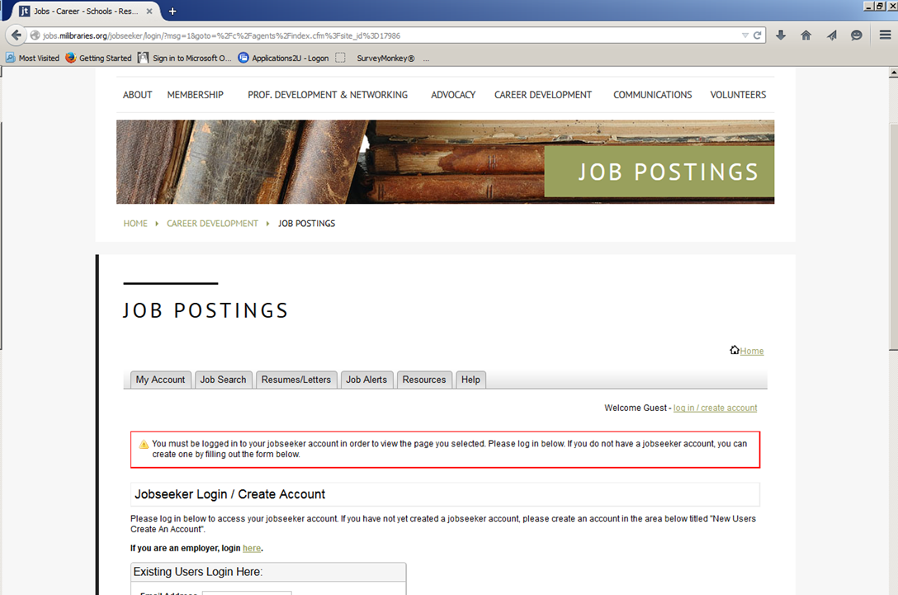
Job Search
Search through the Michigan Library Association's online jobs to find your new career path
www.milibraries.org

Slide 20
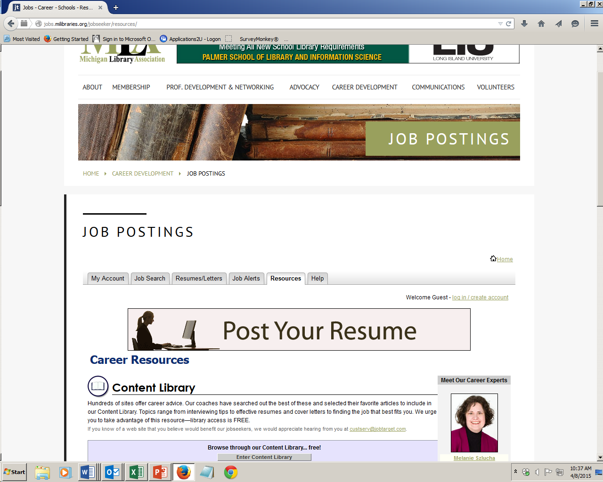
Job Search
Post Your Resume
www.milibraries.org

Slide 21
Impact Your Profession
Set the direction for the future
Collaborate with other students and library professionals
Advance the profession
Learn, teach, present, lead
Advocate for libraries and patrons

Slide 22
Questions?
www.milibraries.org
Contact Information:
Steve Bowers
sbowers@wayne.edu
313-577-6789
Gail Madziar
gmadziar@milibraries.org
517-394-2774

