Slide 1
The Best Life Business:
A New Approach to Library Programs & Services
Laura Fawcett
Program Librarian
fawcettl@cantonpl.org

Slide 2
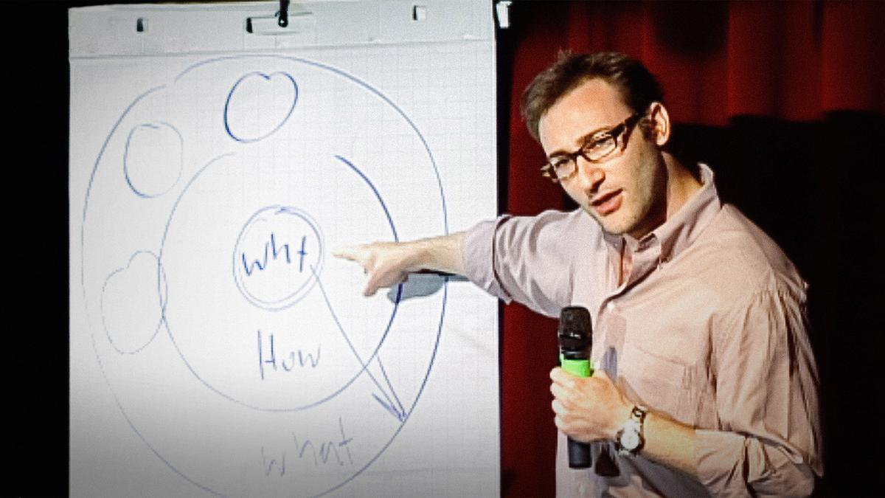
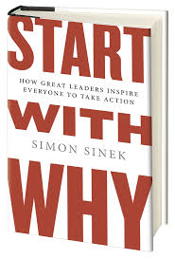
Start With Why

Slide 3
Best Life Business vs. Public Library Business
Best Life Facilitators
Dedicated to Strengthening the Community
Books and Traditional Library Programs Still Very Important
Not One Size Fits All
Don’t Waste Time On Solutions to Problems You Don’t Have
Relevant In Face of Changing Technology
Think About Programs and Services In a New Way

Slide 4
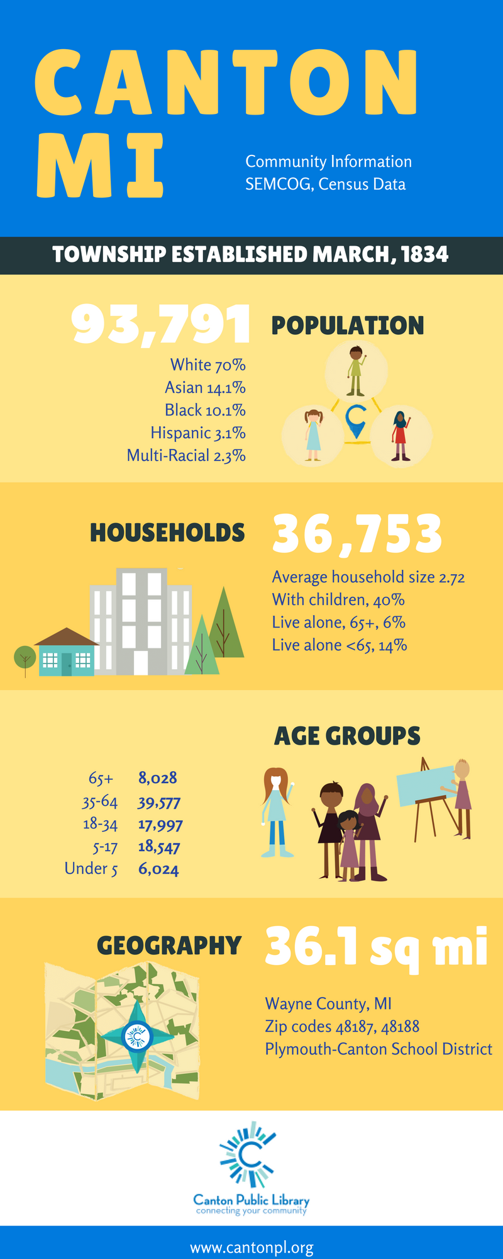
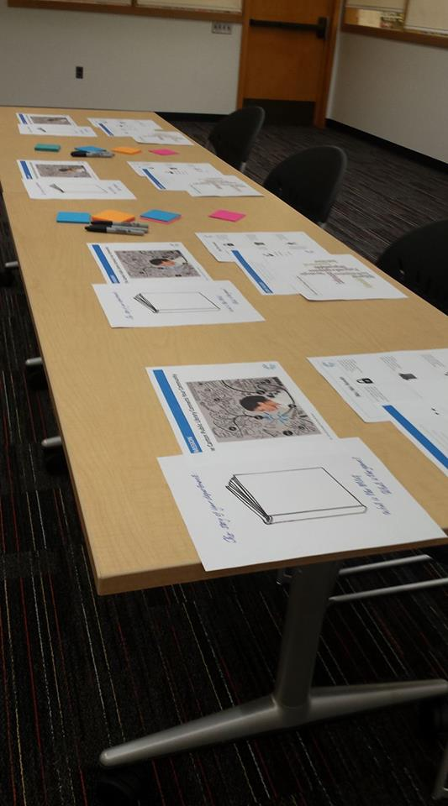
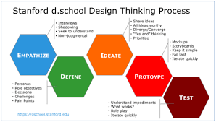
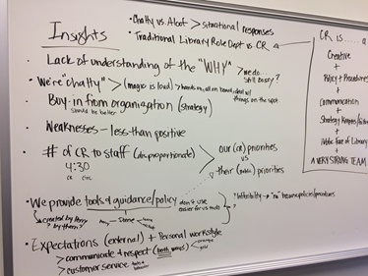
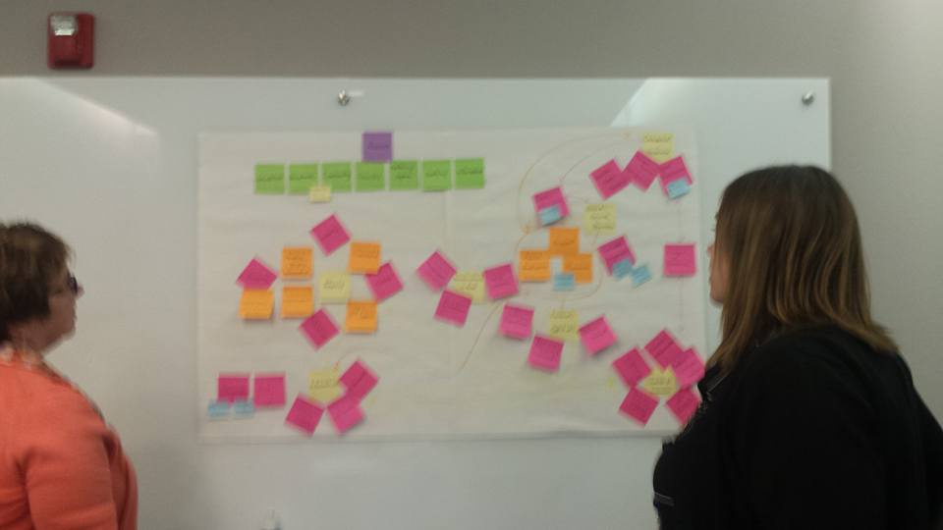
Focus On the User First
Notes:
A library’s WHY should be articulated in its Strategic Plan. At the Canton Public we birthed a new Strategic Plan in 2016. For the first time we used Design Thinking to create this strategic plan. Design Thinking is a Design thinking is a process for creative problem solving.” ... Design thinking encourages organizations to focus on the people they're creating for and leads to human-centered products, services, and internal processes. With design thinking, throwing out what you think you know and starting from scratch opens up all kinds of possibilities.

Slide 6
Notes:
In 2016 we birthed a new strategic plan the summary of which I am going to play for you now.

Slide 7
Outcomes
Learn Something New
Trusted Experts
Meaningful Connections
Have Fun
Feel Welcome
Meets Me Where I Am

Slide 8
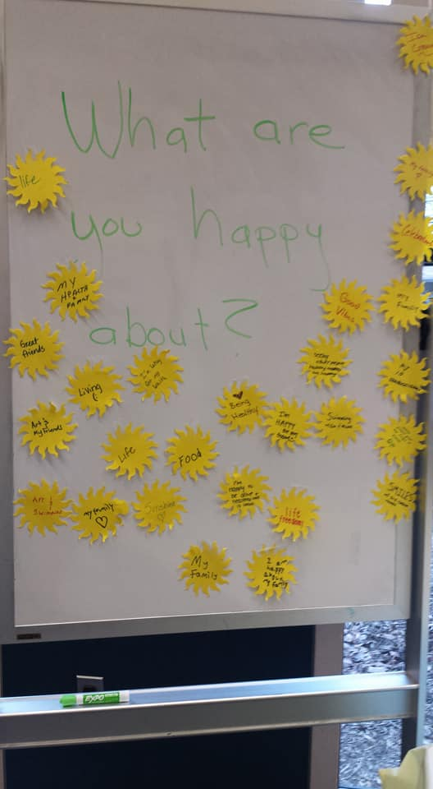
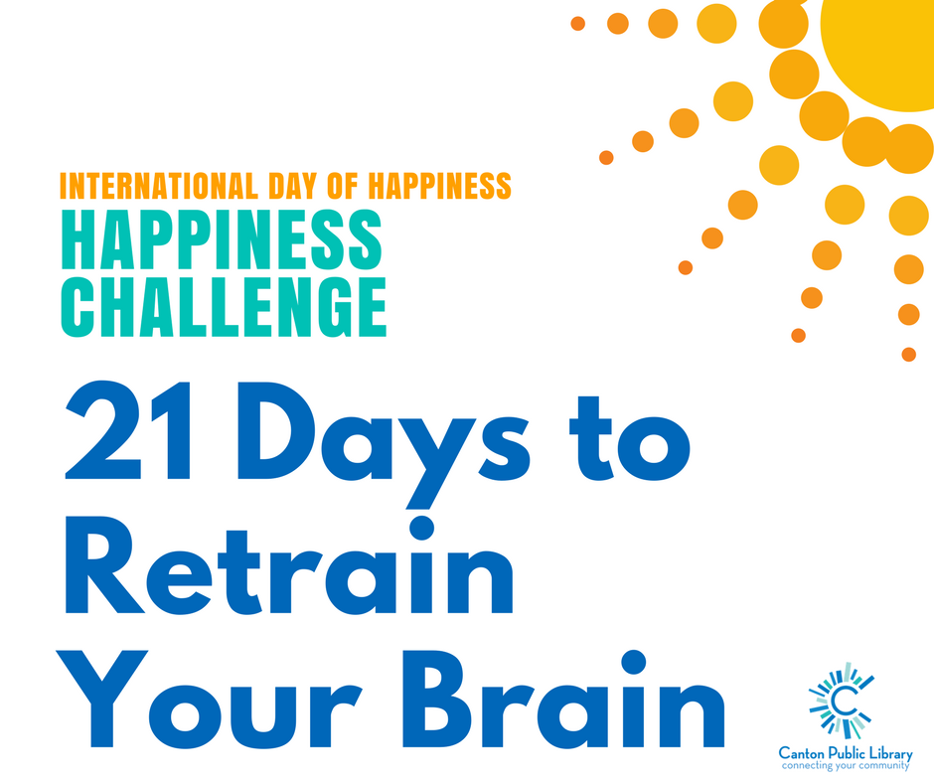
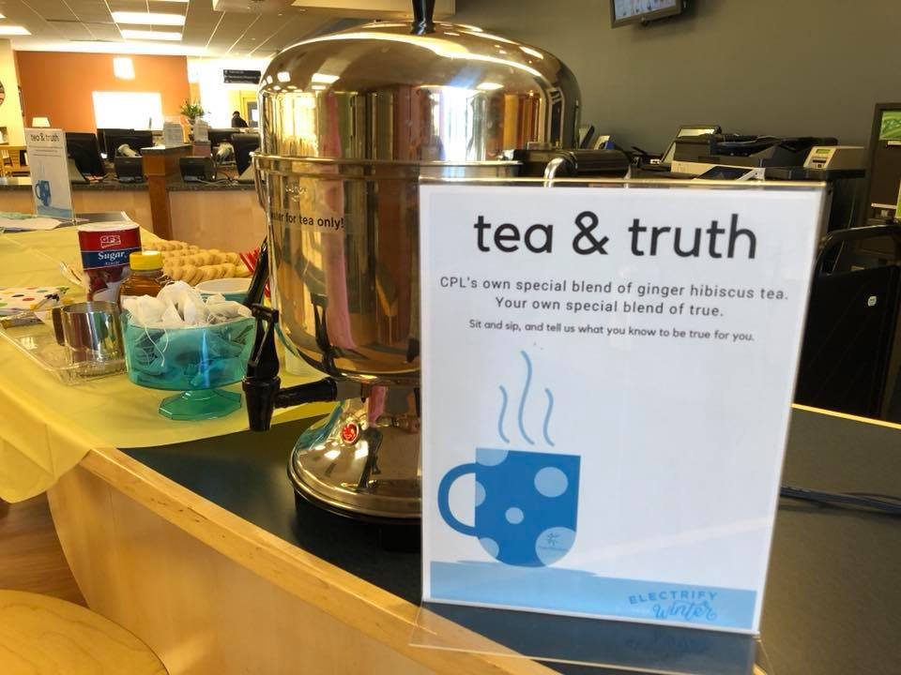

Slide 9
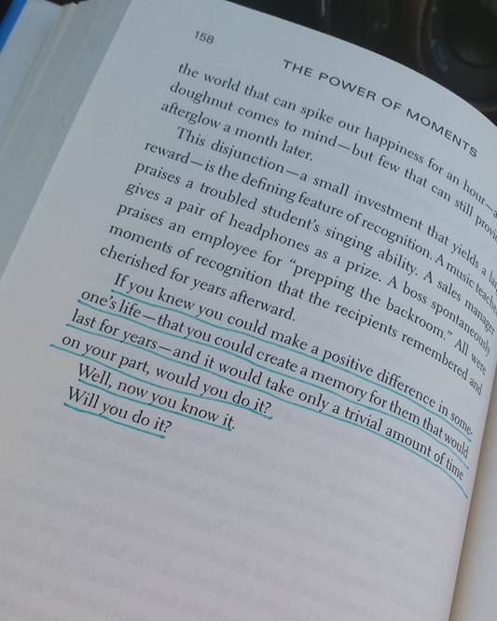
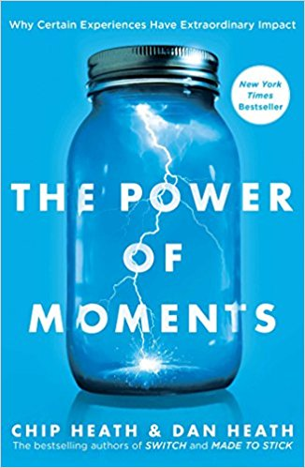

Slide 10
Cocoa and Compliments

Slide 11
Questions?
Thank you!
Laura Fawcett
Best Life Facilitator
fawcettl@cantonpl.org

